Slide 1

Micro-services:
Towards to reproducible science
oVirt 2020 online conference
07.01.2020
Dr. Arman Khalatyan
Researcher at eScience/Supercomputing/IT
Leibniz-Institut für Astrophysik Potsdam (AIP), Germany
1

Slide 2
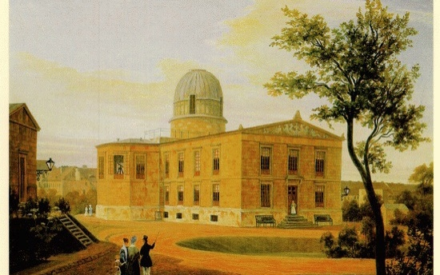
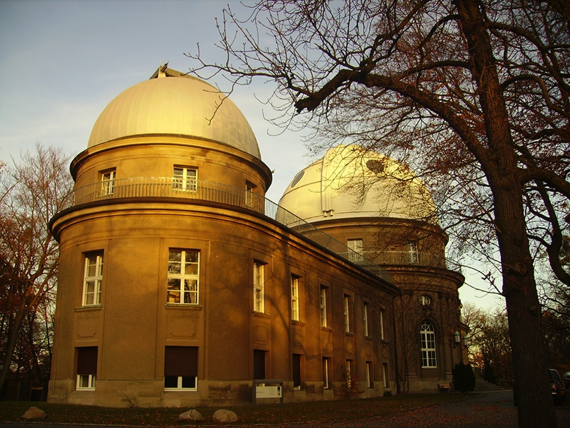
From Berlin to Babelsberg
  The Berliner Sternwarte in Berlin-Dorotheenstadt, today Berlin-Mitte.
  The new Sternwartengebäude in Babelsberg, built 1913.
  The Berliner Sternwarte, founded in 1700, moved to 1913 Babelsberg because the growing city made scientific observations difficult. Light pollution and vibrations from traffic being the main reasons

Slide 3
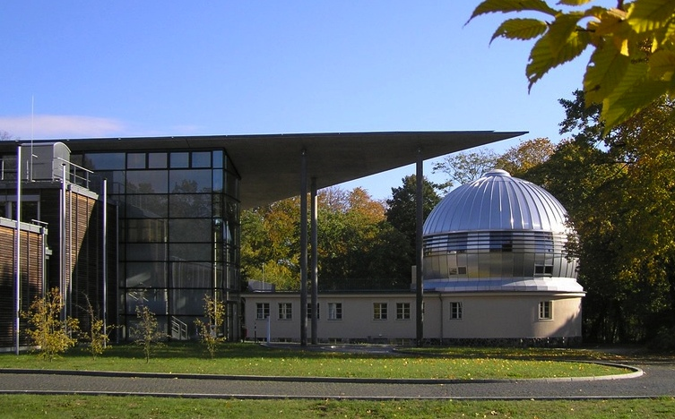
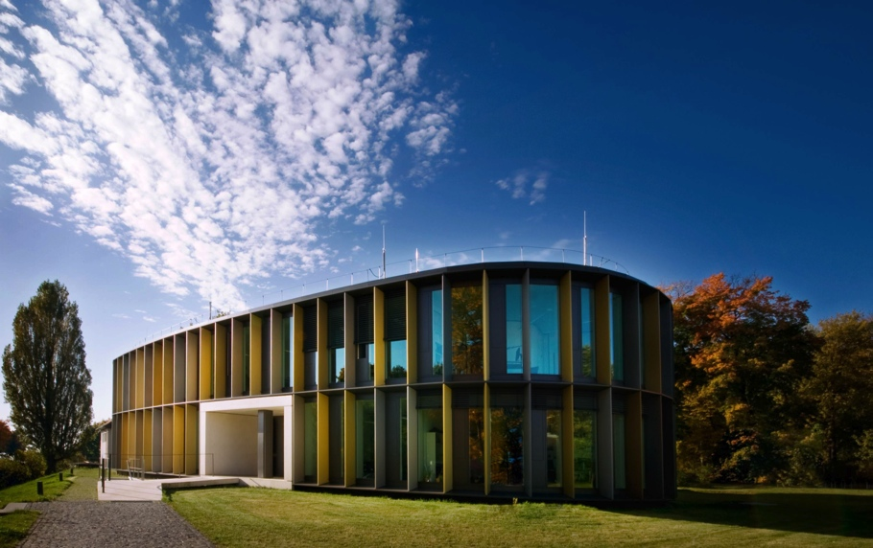
Changing Names
From the Zentralinstitut für Astrophysik (1969) after the wall came down the Astrophysikalische Institut Potsdam (1992) was founded. In 2011 ithe AIP was renamed to Leibniz-Institut für Astrophysik Potsdam (AIP), to emphasize the membership with the Leibniz-Gemeinschaft.

Slide 4
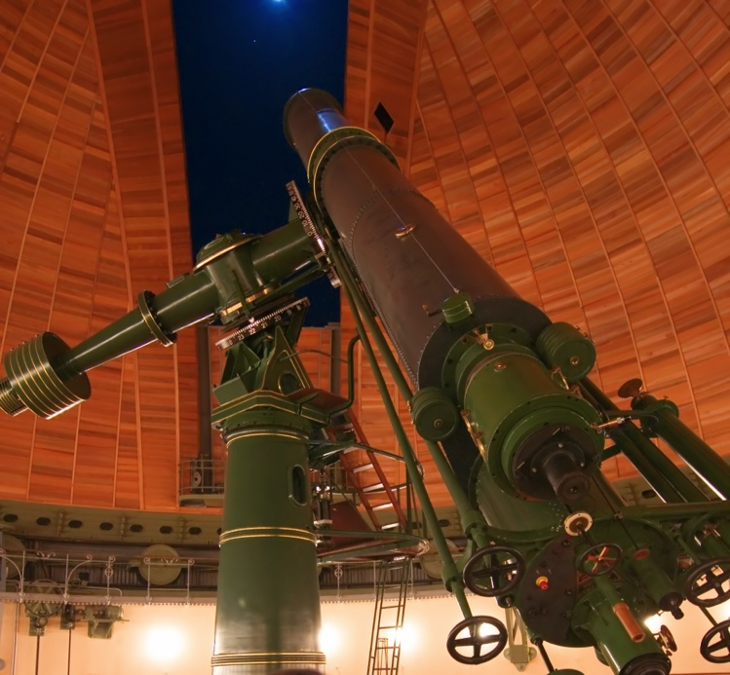
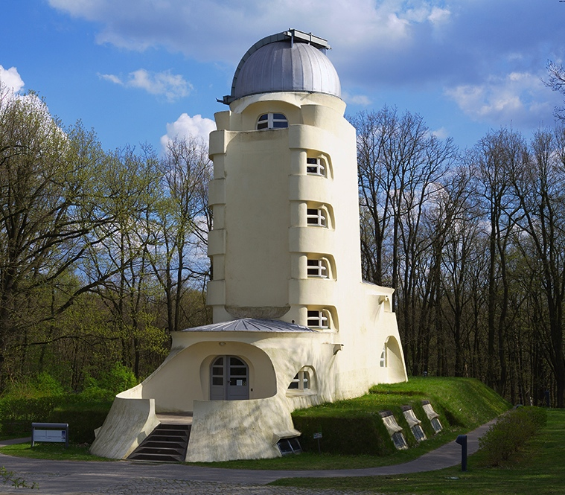
Potsdam Highlights
The Große Refraktor of 1899 ensured a leading role of AOP astrophysics then.
The Sun observatory Einstein tower was built 1919-1924 by Erich Mendelsohn and is considered a milestone in architecture.
Virtual reality tours: https://vr.aip.de

Slide 5
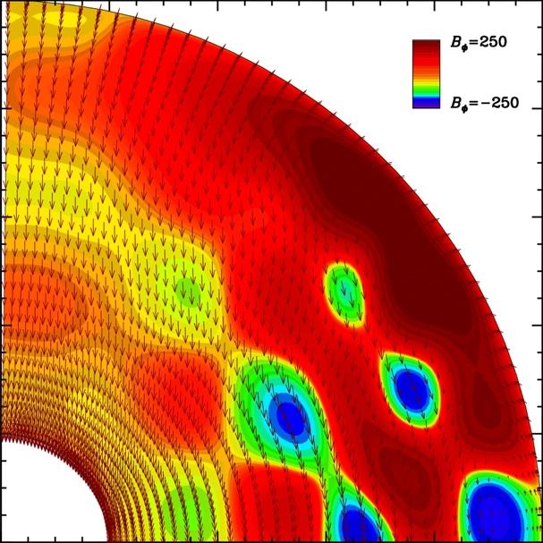

Research Areas
Cosmic Magnetic Fields
Research on solar, stellar and galactic magnetic fields and magnetohydrodynamic (MHD) mechanisms.
Extragalactic Astrophysics
Active galaxies and quasars. Galactic archaeology and extragalactic research based on high resolution simulations.
https://www.aip.de

Slide 6
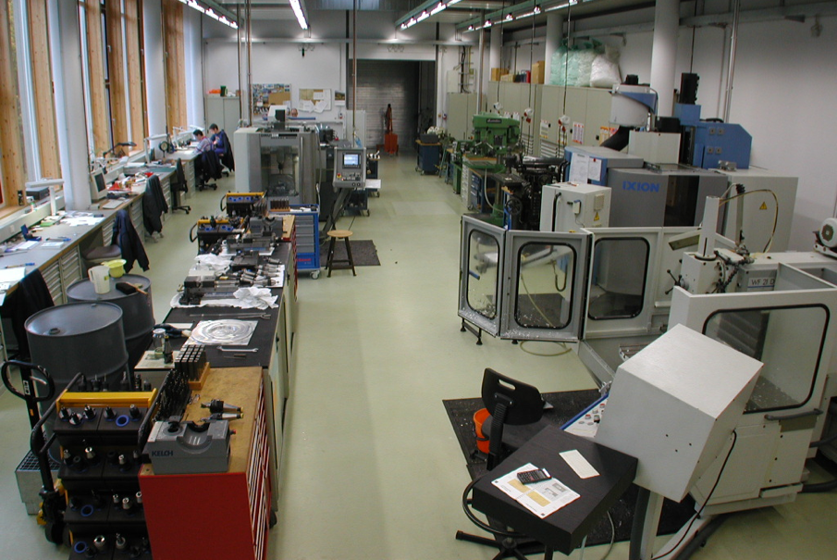
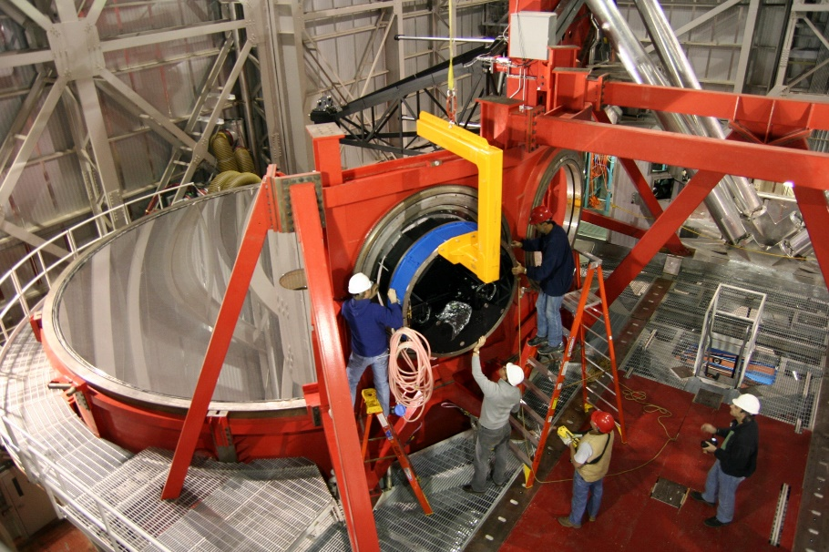
Research technology and infrastructure
„Development of Research technology and infrastructure“ ensures the scientific endeavors of AIP and also its participation in international astronomical projects. AIP has construction workshops and labs for instrumentation, especially with fiber optics, ex: AIP is lead institute of the 4MOST project a fibre-fed spectroscopic survey facility on the VISTA telescope, op-2021)

Slide 7
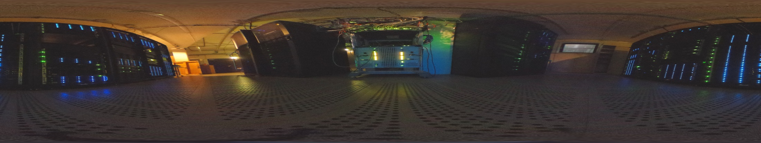
Research technology and infrastructure
Supercomputing and E-Science
Compute Cluster
Simulations in
Cosmology &
Magneto-Hydro-Dynamic
Leibniz: 1700 Cores
Newton: 1024 Cores
Storage / Archives / Database
Simulation and observation data
ca. 2 Petabyte Storage,
Virtual Research Environment for CLUES, MUSE
Databases: CosmoSim, RAVE, Gaia,Plates Archives

Slide 8
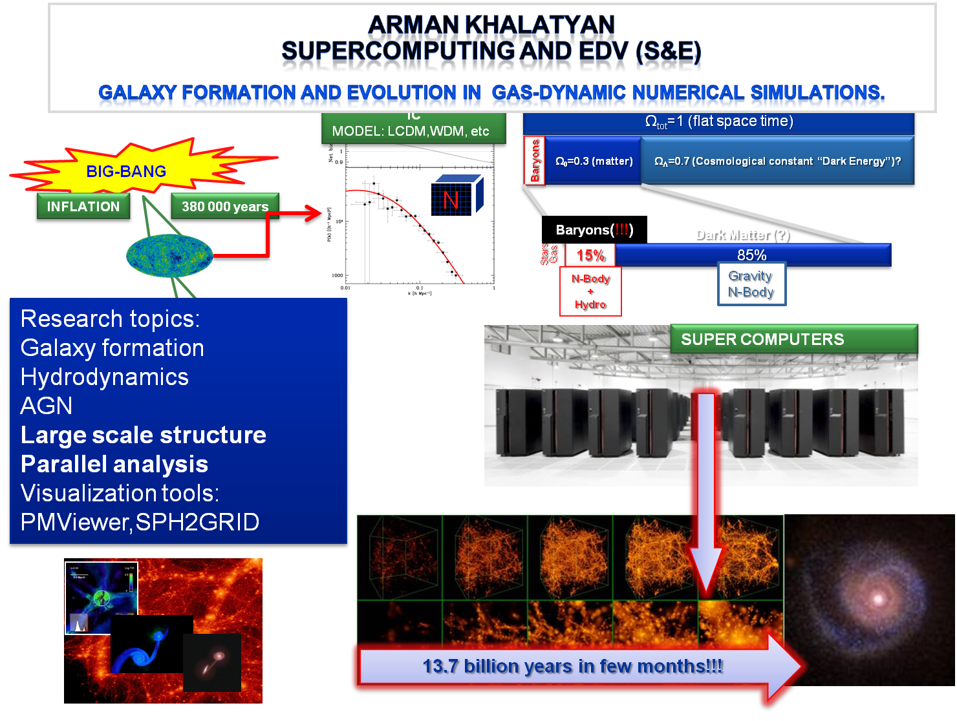

Slide 9












Open source tools are used whenever is possible
SYSTEM
Monitoring
Deployment
File systems
Virtualization

Slide 10
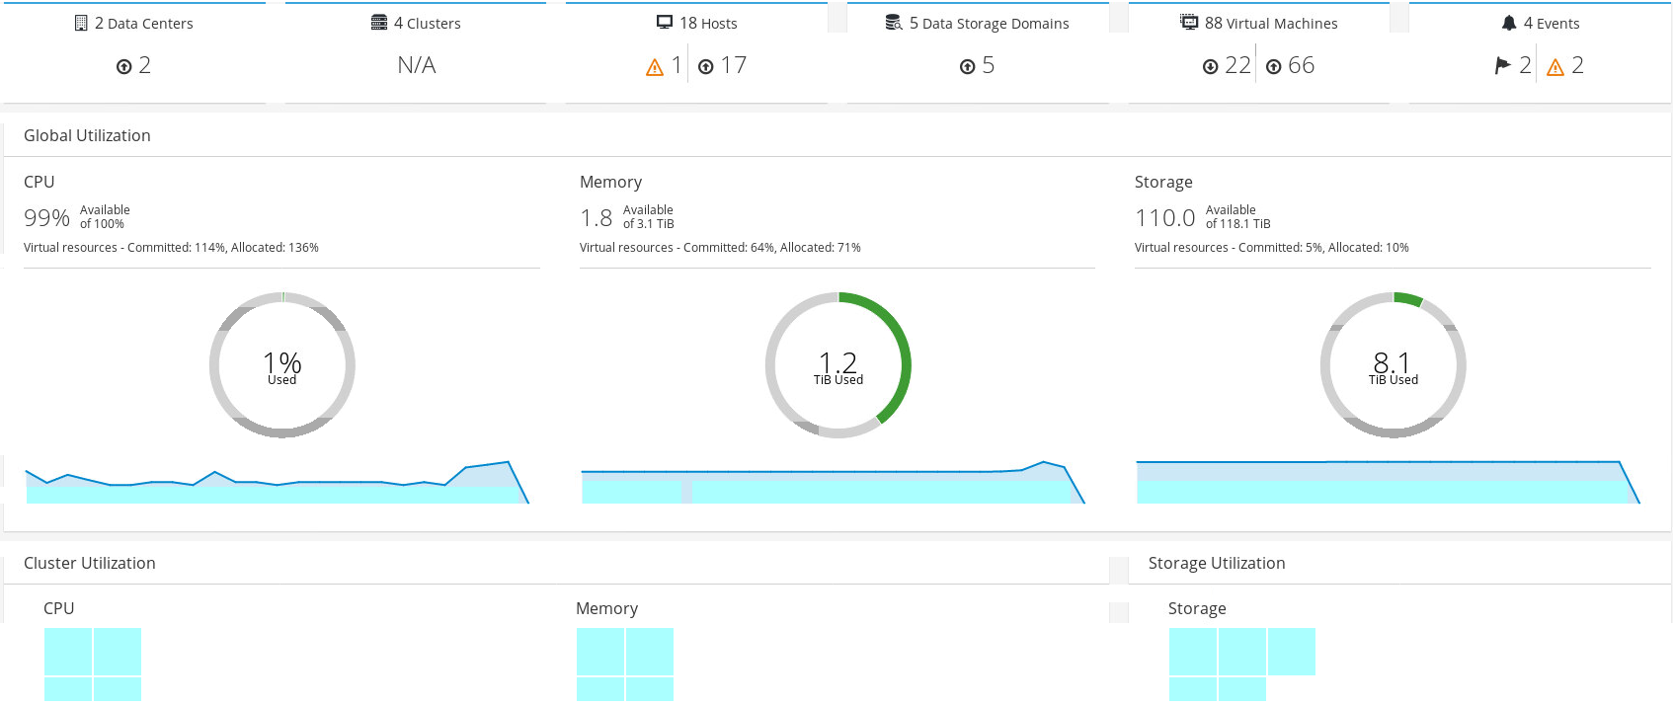
oVirt at AIP
>18Hosts, >80VMs, >20HPC VMs
Since oVirt 3.5(~2016) we are using it for the webpages/data reduction/testing
oVirt has a very supportive community, similar like: glusterfs and zfs

Slide 11
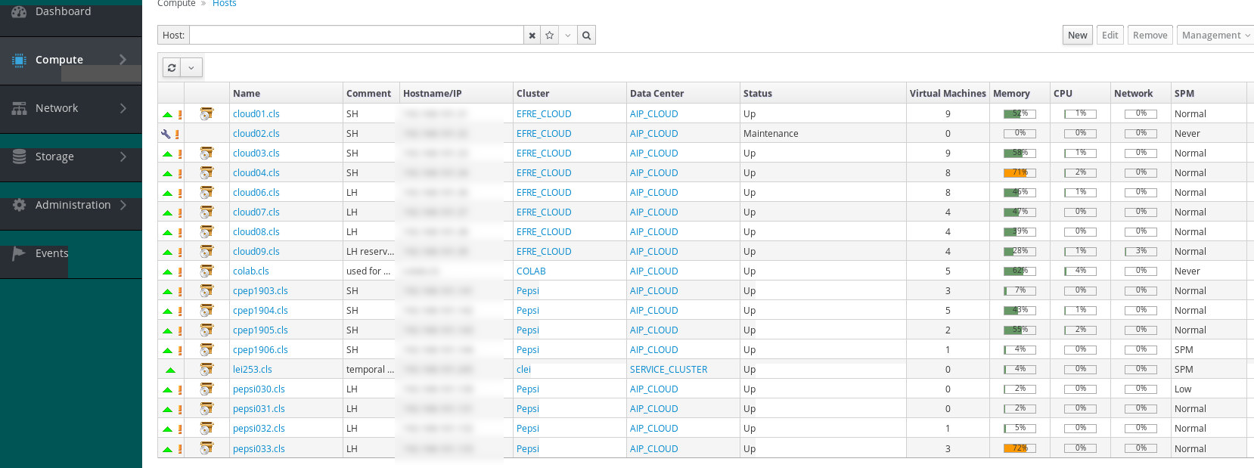
oVirt at AIP
HPC VMs – Used for data reduction, in production time we get load spikes CPU/Net 99.9%
VMs nodes with legacy code - no internet, just data connection over 10Gbit interface.
Every major release upgrade makes us very nervous

Slide 12
What do we expect?
VMs with low load should wakeup quickly
Parallel disk IO to deal with TBs of data
  Connection with Lustrefs
Easy to maintain
Clone service on demand
Reuse/reshare unused resources
Snapshots for versioning of the data-pipelines
24/7 HA
Spatial hardware share: GPU, SSD, NVME

Slide 13

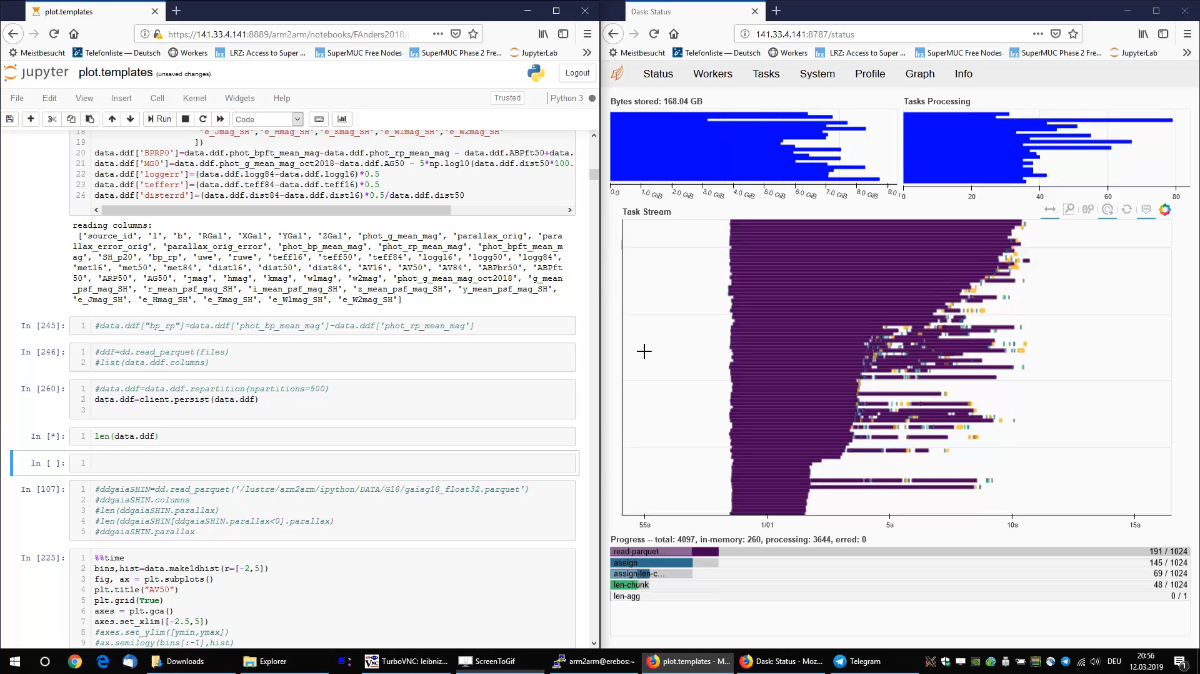
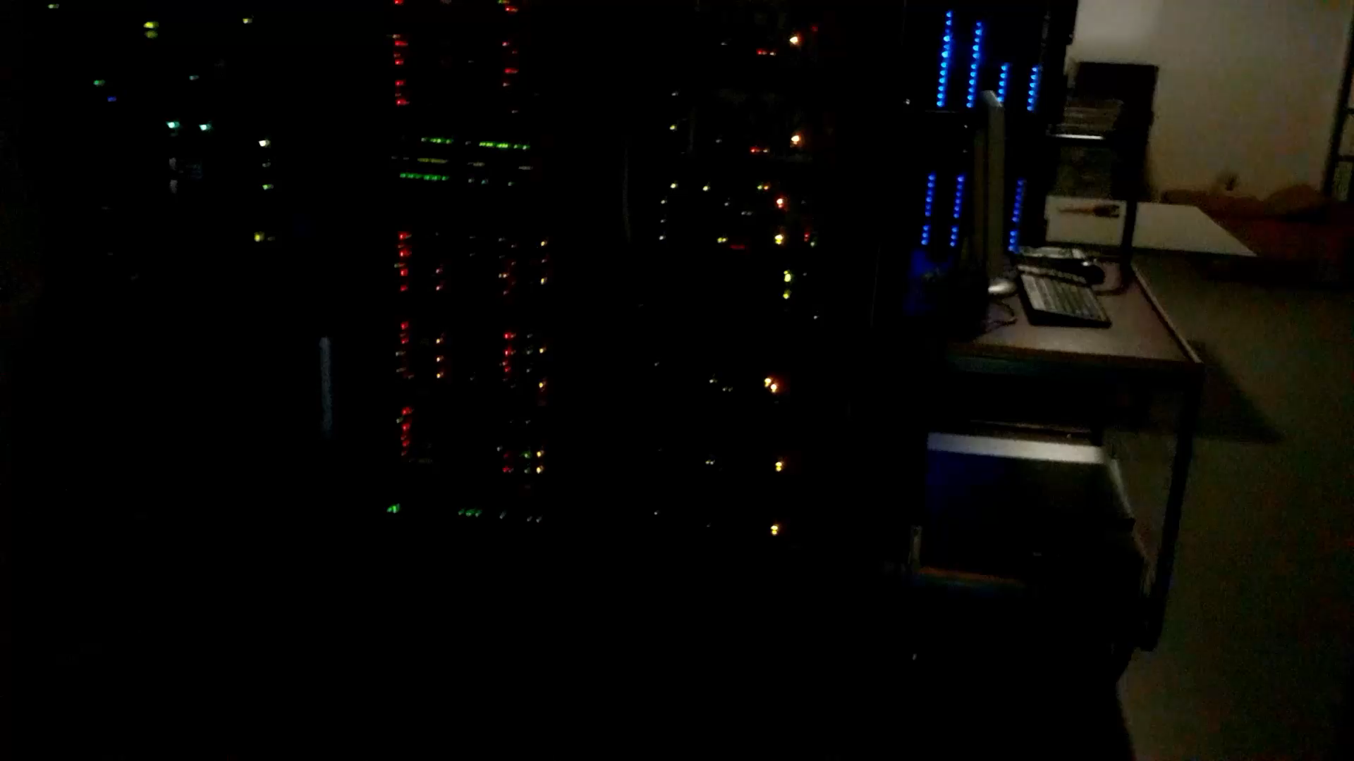
The whole complexity is obscured from the users
Users want the all tools in one place
Data+LaTex+Code
Collaborators to share
Article versions
Cluster access
Easy publishing for the demo notebooks
Possible solution:
dask+Kubernetes
CoCalc project
CoCalc is a web-based cloud computing and course management platform for computational mathematics.
Part of the Sage project, it supports editing of Sage worksheets, LaTeX documents and Jupyter notebooks.
Notes:
Hiding the whole complex infrastructure

Slide 14










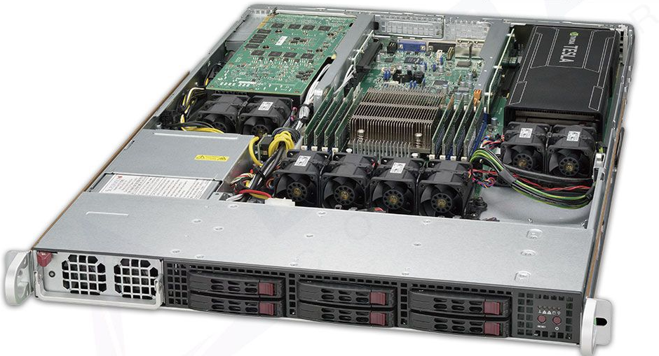


What is the goal at AIP?
User with
data and algorithms
Libraries
Hardware with accelerators
colab.aip.de
Hide complexity
GaiaData
WEB BROWSER
Python
Interactive plots
Share
Latex
HPC
GPU
HPC clusters,
LustreFS,
IB,10Gbit

Slide 15
Benchmark: storage
Parquet data size:
Pure(small) - 64GB
LZ4(small) - 64GB
Gaia(all) - 64GB
As a benchmark we read with the python/dask library a small chunk of the
GaiaDR2 satellite data
As a benchmark we read with the dd and md5sum a small chunk of the GaiaDR2 satellite data

Slide 16
Ai-benchmark: GPU
oVirt GPU hostdev passthrough benchmark
Gamer Overclocked RYZEN 3990X
cocalc@colab.aip.de
http://ai-benchmark.com/ranking_deeplearning.html

Slide 17
Microservices: Reproducible science
Use Cases at AIP
Colab.aip.de
  Quotas
  Project isolation
Data analysis pipelines with versioning
  Reproducible science
  Pipeline versioning
    GaiaDR1,2,3
    RAVEDR1-6
    StarHorse-18,19,20
Publish papers with interactive plots
  like binder
  Example: distill.pub by google
Dynamically Scalable webpages
gitlabs @ aip: CI integration
Pros:
Direct GIT integration
Scalability
Modularity
Distributed development
Integration
Save resources/power
Concerns:
Complexity
Design
Testing, debugging
Inter-service call latency
17

Slide 18
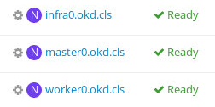
OKD 3.11: 3 node deployment.
okd.cls
https://console.okd.cls:8443/
DNS config:
master0.okd.cls IN A 192.168.101.120
infra0.okd.cls IN A 192.168.101.121
worker0.okd.cls IN A 192.168.101.122
.apps.okd.cls. 300 IN A 192.168.101.121
+ 1 aliase
192.168.101.120 console.okd.cls
Hard to deploy(DONE):
>10 Unfixed bugs, digging in github and ansible sourcecode
18

Slide 19
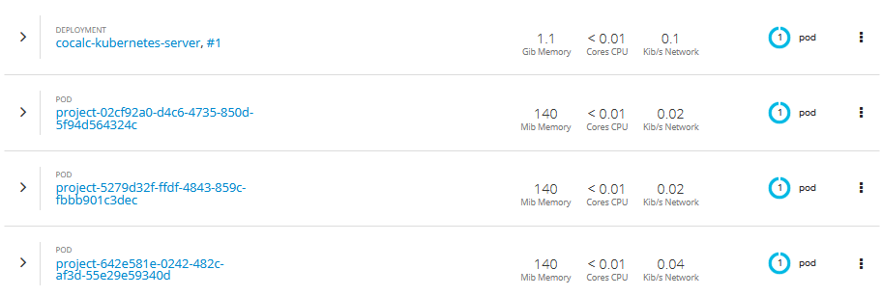
Upcoming colab.aip.de vision
OKD Infrastructure
https://cocalc-kubernetes-server-colab.apps.okd.cls
User1
User2
User3
Project1
Quota:CPU/SPACE/RAM
Project2
Quota:CPU/SPACE/RAM
pod1
pod2

Slide 20
Example: App deployment
https://production-okd-panel-472.apps.okd.aip.de/
gitlab
python
docker
CI
deployment
Stage
Produktion
APP
WEB
Service
https://staging-okd-panel-472.apps.okd.aip.de/
https://gitlab.aip.de/akhalatyan/okd-panel

Slide 21
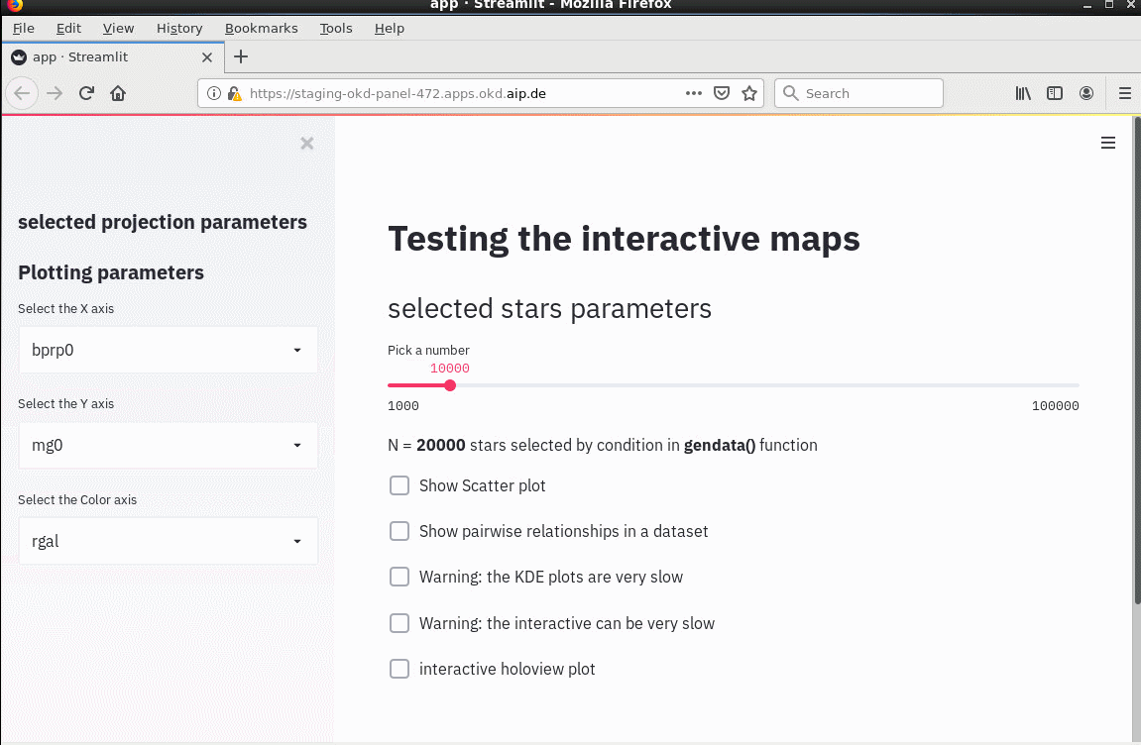
Example APP for a published data(streamlit)

Slide 22

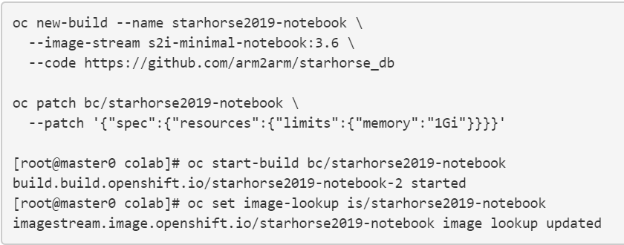
Deploy example from the github
TASK:
  Let us deploy an example from: https://github.com/arm2arm/starhorse_db
You can use WebInterface: https://console.okd.cls:8443/
Commandline remotely with oc tools:
  https://colab.aip.de/projects/e6072404-d38d-400d-b85f-f0bd13743737/files/usage/jupyter-hub-custom.md
Source-to-Image (S2I) is a toolkit and workflow for
building reproducible container images from source code.

Slide 23
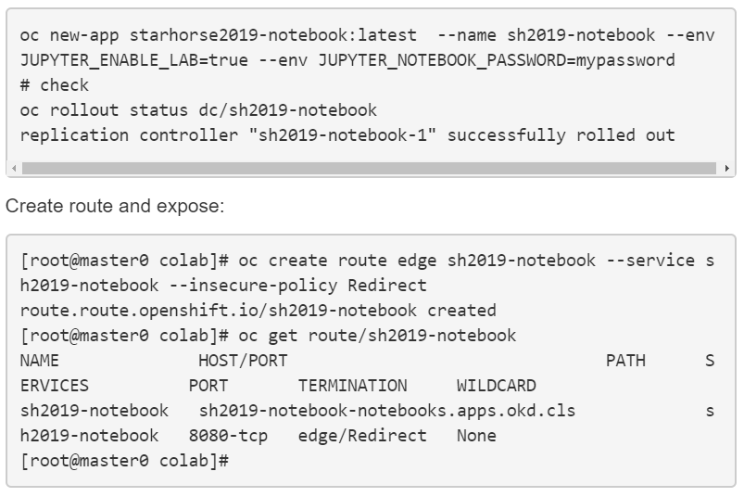
Deploy example from the github

Slide 24
Conclusion
oVirt is a well suited for academic workloads
We have shown a concept on reproducible pipelines for the paper publishing.
OKD is a promising project for our needs
Nice to have:
LTS of oVirt+OKD as a part of the CentOS ☺
Easy integration with the Infiniband+10G infrastructures.
Missing puzzle is a storage, GlusterFS is still slow for us.

Slide 25
Thank you for your attention.

Slide 26
References
https://en.wikipedia.org/wiki/Microservices
https://www.okd.io/
http://v1.uncontained.io/playbooks/installation/
https://www.docker.com/
https://github.com/sagemathinc/cocalc
https://github.com/streamlit
https://dask.org/
https://docs.okd.io/3.11/creating_images/s2i.html

Slide 27
Supplementary slides:
Microservices explained on vr.aip.de

Slide 28
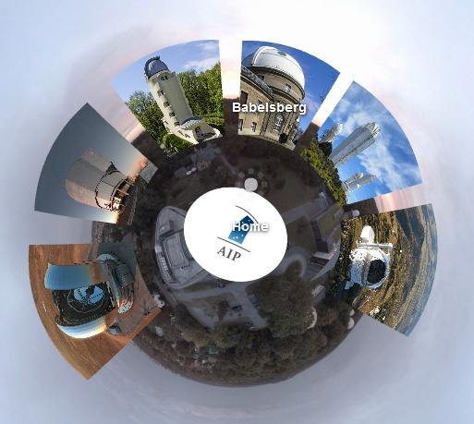
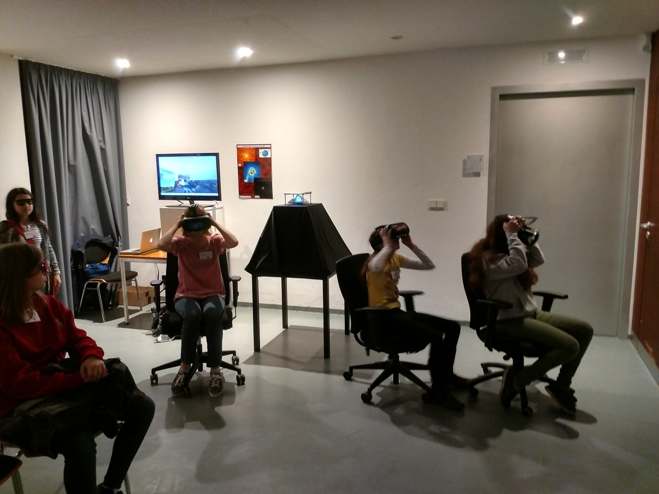
https://vr.aip.de

Slide 29
Example: Monolith architecture
https://vr.aip.de
Problems
Security:
Updates
External attacks
request_sock_TCP: Possible SYN flooding on port 443
vr.vm: 141.33.4.145:4Cores:8GB
Scale
UP
OS:Ubuntu 16.04:custom ffmpeg
Apache 2.x
Load:
Static Pages
/var/www/vrpage
Open Doors day:
3000 Users in 2hours
  1 user >1Mln requests
WordPress 2.5
90% of year:
2/3 Users per day
PHP:7.x Pages
/var/www/wp
MariaDB:10.x
Events regular days:
100-200 users per day

Slide 30
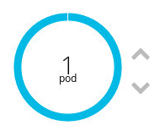
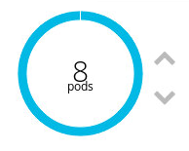
Example: Distributed architecture
https://vr.aip.de
OpenShift Container Platform leverages the Kubernetes concept of a pod, which is one or more containers deployed together on one host, and the smallest compute unit that can be defined, deployed, and managed.
OpenShift Cluster
Scale
UP
Application: Vr.aip.de
Pod:
router
WordPress
Pod:
Apache
Pod:
NFS
Static pages
Service1
Pod:
NFS
Static pages
Pod:
Apache
Pod:
MySql Cluster
Pod:
Galera node1
Scale OUT

